Slide 1
New Perspectives on Microsoft Excel 2019

Slide 2
Managing Data with Data Tools
Module 6

Slide 3
Objectives, Part 1
Split a workbook window into panes
Highlight and remove duplicate values in a data range
Sort a data range by one or more fields
Add subtotals to a data range

Slide 4
Objectives, Part 2
Find and select workbook cells
Filter data based on one or more fields
Create an advanced filter
Convert a data range to an Excel table
Work with table styles and table elements

Slide 5
Objectives, Part 3
Create and apply a slicer
Calculate summary statistics with the SUBTOTAL function
Design and create an interactive dashboard

Slide 6
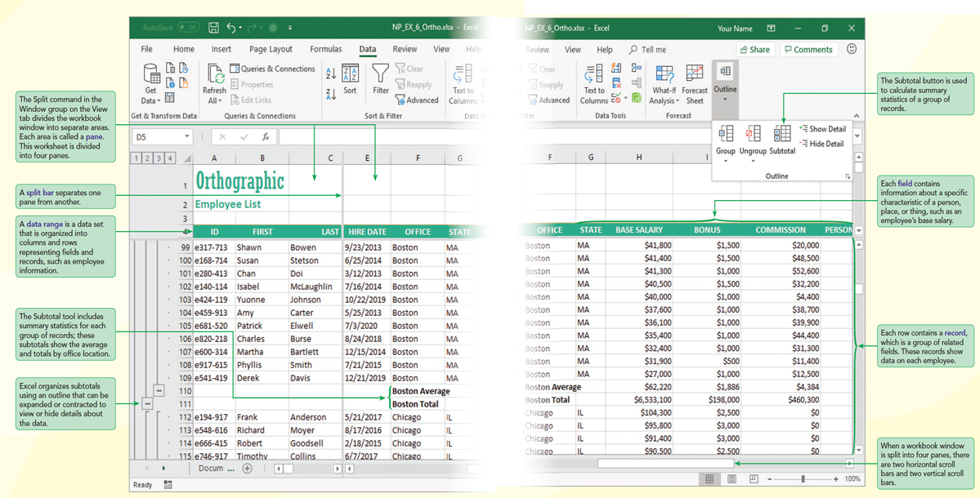
Visual Overview: Data Ranges, Workbook Panes, and Subtotals

Slide 7
Handling Data in Excel, Part 1
Excel is a popular application for storing data and includes tools for managing and exploring that data.
In a data range, each column stores information known as a field describing a characteristic of a person, place, or thing and each row stores a record containing a group of related field values.
The first row of a data range, known as the header row , typically contains the field names.

Slide 8
Handling Data in Excel, Part 2
With any data range, it’s excellent practice to provide a data definition table , which lists the fields included with each record, the type of data stored in each field (such as numbers, text, or dates), and a short description of each field.

Slide 9
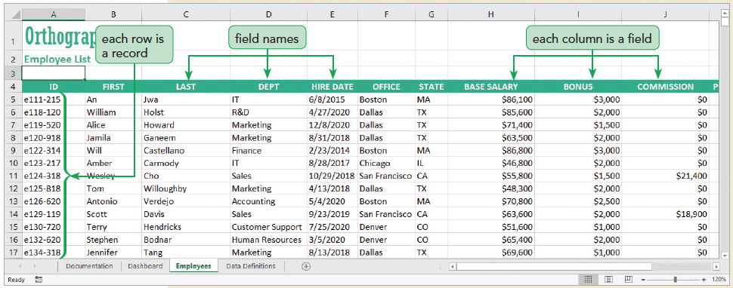
Handling Data in Excel, Part 3

Slide 10
Using Panes to View Data, Part 1
Dividing the Workbook Window into Panes
Excel can split the workbook window in up to four sections called panes with each pane offering a separate view into the worksheet
Freezing Panes
When you freeze a pane, its contents are always visible though you cannot scroll within it. You can freeze the panes located to the top and left of a selected cell, allowing scrolling within the lower-right pane

Slide 11
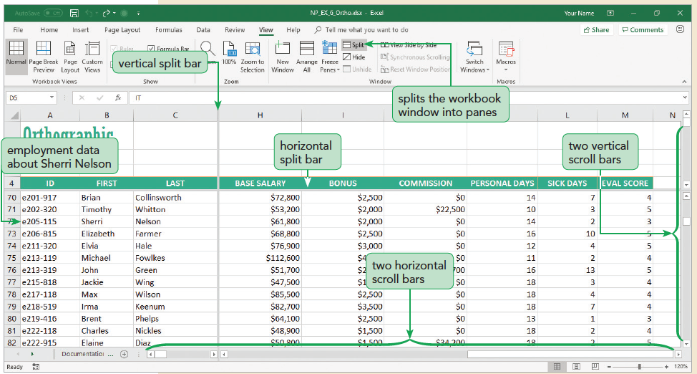
Using Panes to View Data, Part 2

Slide 12
Locating Duplicate Records, Part 1
When a worksheet has a lot of data, data entry errors are almost sure to occur.
One common error is creating a duplicate record in which the same record appears multiple times in the worksheet.
Highlighting Duplicate Values
You can use conditional formatting to locate a duplicate record by highlighting duplicate values within a selected range

Slide 13
Locating Duplicate Records, Part 2
Removing Duplicate Records
Click any cell in the data range.
On the Data tab, in the Data Tools group, click the Remove Duplicates button.
Select the check boxes for the fields that you want to check for duplicates.
Click OK to remove records containing duplicates of all of the selected fields.

Slide 14
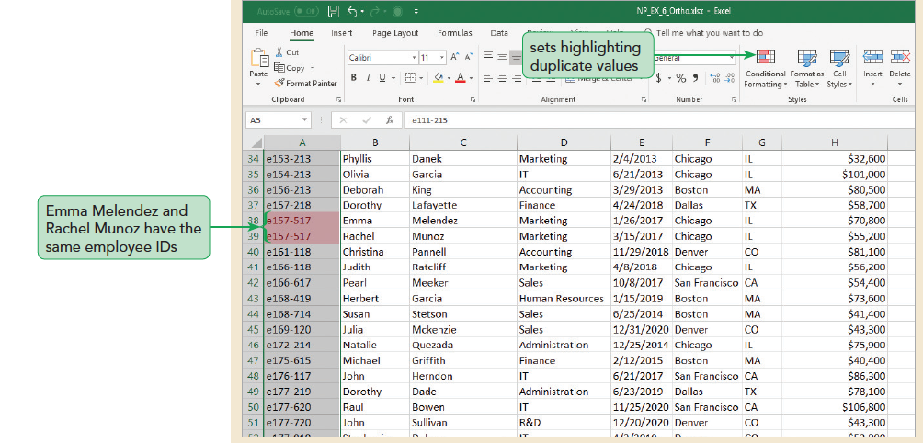
Locating Duplicate Records, Part 3

Slide 15
Sorting Records in a Data Range, Part 1
Sorting by a Single Field
The records in an Excel table initially appear in the order they were entered; you can view the same records in a different order
Ascending order arranges text alphabetically from A to Z, numbers from smallest to largest, and dates from oldest to newest
Descending order arranges text in reverse alphabetical order from Z to A, numbers from largest to smallest, and dates from newest to oldest
Use the Sort A to Z button or the Sort Z to A button to sort data quickly with one sort field

Slide 16
Sorting Records in a Data Range, Part 2
Sorting by Multiple Fields
The first sort field is called the primary sort field
The second sort is called the secondary sort field
Up to 64 sort fields possible

Slide 17
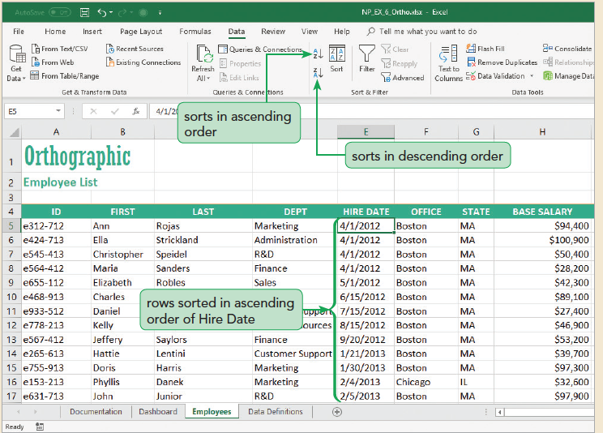
Sorting Records in a Data Range, Part 3

Slide 18
Sorting Records in a Data Range, Part 4
Sorting with a Custom List
A custom list indicates sequence to order data
Two predefined custom sort lists
Day-of-the-week custom list
Month-of-the-year custom lists
Can create a custom list to sort records in a sequence you define

Slide 19
Calculating Subtotals, Part 1
Creating a Subtotal Row
Some analysis requires calculations on sections of a data range. To do this, you can add subtotals , which are summary functions that are applied to a part of a data range
Using the Subtotal Outline View
The outline tool lets you control the level of detail displayed in the worksheet.

Slide 20
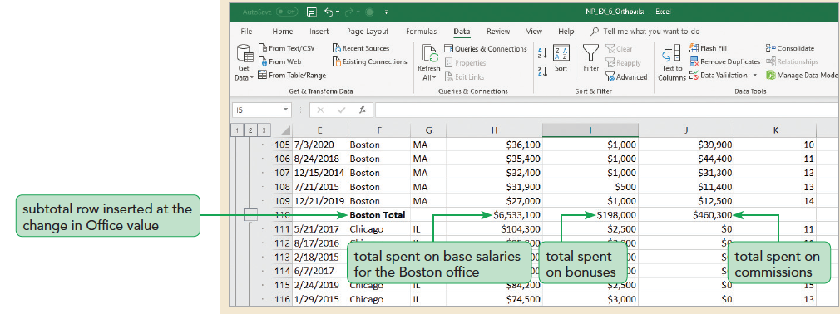
Calculating Subtotals, Part 2

Slide 21
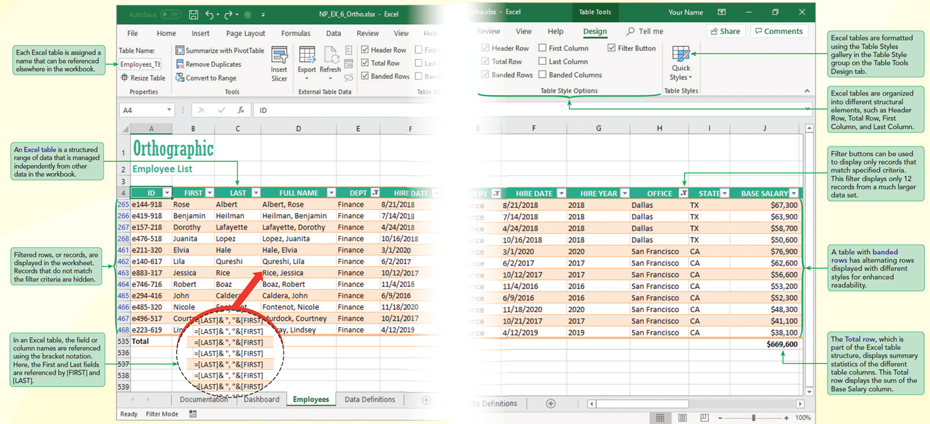
Visual Overview: Filters and Excel Tables

Slide 22
Locating Cells Within a Worksheet, Part 1
Finding and Selecting Multiple Cells
Find & Select can locate cells that match a specified criterion. For example, you can use Find & Select to locate employees by their last name, base salary, or date of hire.
Finding Cells by Type
Find & Select can also locate cells based on criteria other than cell value, such as whether the cell contains a formula, constant, blank, or conditional formatting rule.

Slide 23
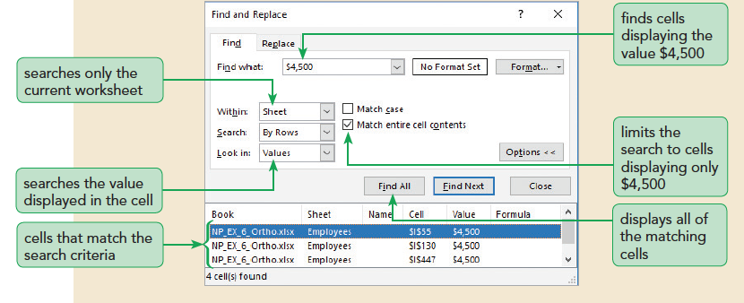
Locating Cells Within a Worksheet, Part 2

Slide 24
Filtering Data, Part 1
Filtering Based on One Field
Filtering data hides the rows whose values do not match the search criteria. Those rows are not removed from the worksheet. They can be redisplayed by removing the filter or applying a new filter

Slide 25
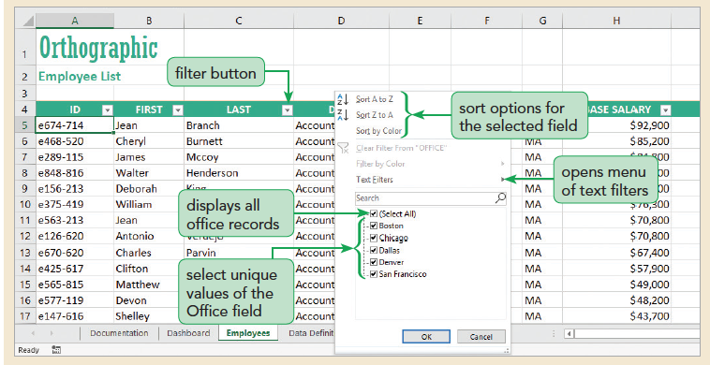
Filtering Data, Part 2

Slide 26
Filtering Data, Part 3
Filtering Based on Multiple Columns
You can filter a data range based on criteria from multiple fields. Each additional filter reduces the number of records displayed since a record has to fulfill all filter criteria to be selected.
To use filters from multiple fields, select the filter button from other column headers in the data range.

Slide 27
Filtering Data, Part 4
Using Criteria Filters
The filters created are limited to selecting records for fields matching a specific value or set of values.
For more general criteria, you can create criteria filters, which are expression involving dates and times, numeric values, and text strings.
Clearing Filters
Once you have the information you need from the filtered data range, you can clear all the filters, revealing any hidden rows and columns. You’ll clear the date filters from the employees list.

Slide 28
Filtering Data, Part 5
Applying an Advanced Filter
Advanced filtering provides a way of writing more complicated filter criteria that involve expression that combine fields using the AND and OR logical operators.
To write an advanced filter, you must define a criteria range that lays out the specifications of the filter

Slide 29
Creating an Excel Table, Part 1
Converting a Range to a Table
Excel tables support several features that are not available with data ranges, including:
Sorting and filtering tools built into the table itself
Table styles to format different features of the table, including banded rows and columns
Automatic insertion of a totals row containing summary statistics for each field, which update as records are inserted or deleted
Calculated values that use field names rather than cell references to make formulas easier to write and understand
Named references to different parts of the table structure, including table columns, total rows, and header rows

Slide 30
Creating an Excel Table, Part 2
An Excel table has the following structural elements:
Header row—The first row of the table containing the field names
Total row—A row at the bottom of the table containing summary statistics for selected fields
First column—The leftmost column of the table
Last column—The rightmost column of the table
Banded rows—The odd- and even-numbered rows of the table formatted differently to make records easier to distinguish
Banded columns—The odd- and even-numbered columns of the table formatted differently to make fields easier to distinguish
Filter buttons—Buttons next to each field name for filtering and sorting the table data

Slide 31
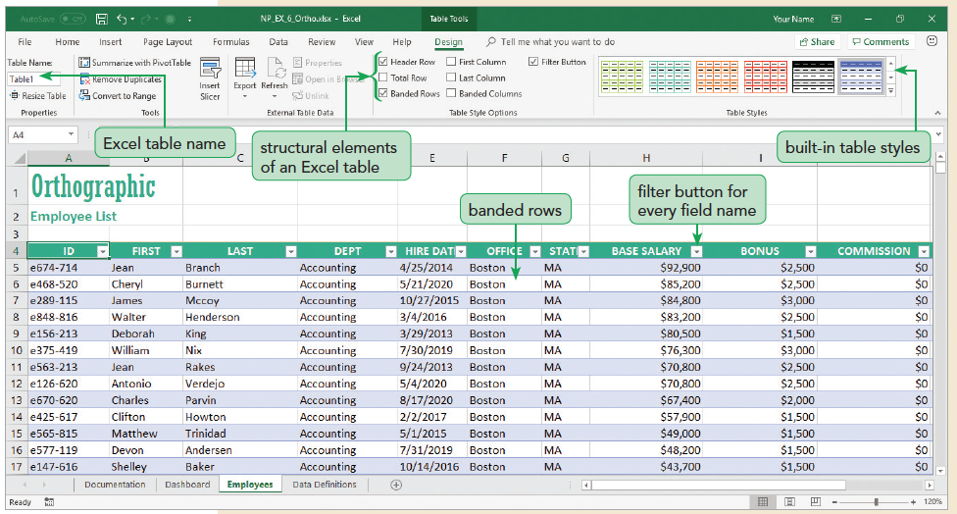
Creating an Excel Table, Part 3

Slide 32
Creating an Excel Table, Part 4
Using Table Styles
Because an Excel table is composed of structural elements, you can apply styles to different parts of the table
Table styles do not, by default, override the formatting applied to individual cells
Adding a Total Row
A useful table element for data analysis is the Total row, which is added to the end of the table after the last data record. The Total row calculates summary statistics, including the average, sum, minimum, and maximum of select fields within the table.

Slide 33
Creating an Excel Table, Part 5
Adding and Deleting Records
When you add or delete records within an Excel table, the table adjusts to the new contents.
The format applied to the banded rows updates to accommodate the new data set size. The calculations in the Total row reflect the new data.

Slide 34
Creating an Excel Table, Part 6
Creating a Calculated Field
So far, all of the fields in the table contain entered values. A field can also contain a formula that references other fields in the table.
Such a field is called a calculated field, and it updates automatically as other field values in the table change. Instead of cell references, formulas in a calculated field use field names enclosed in brackets as follows: [field]

Slide 35
Creating an Excel Table, Part 7
Structural References and Excel Tables
References to fields and elements in an Excel table are called structural references and are enclosed within square brackets [ ].
An important symbol in a structural reference is the @ symbol, which refers to the current record or row within the table

Slide 36
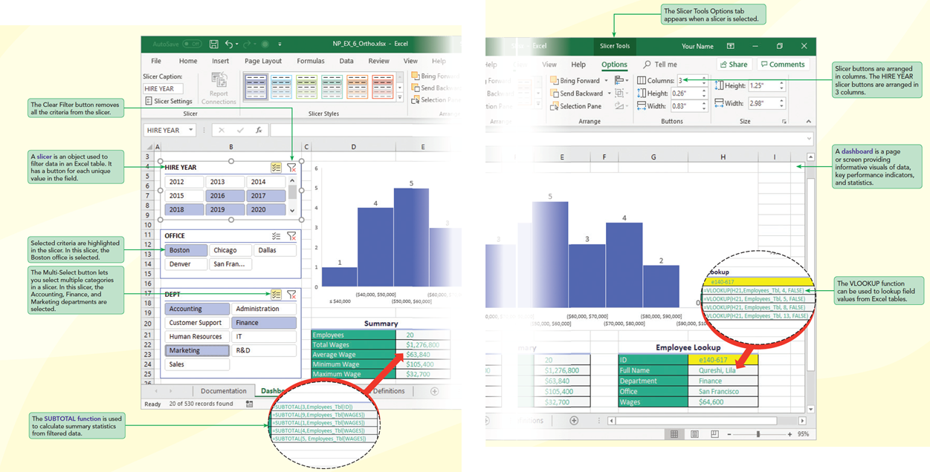
Visual Overview: Slicers and Dashboards

Slide 37
Filtering Data with Slicers, Part 1
Creating a Slicer to Filter a PivotTable
Another way to filter a PivotTable is with a slicer
Can create a slicer for any field in the PivotTable Fields pane
The slicer contains a button for each unique value in that field
You can format the slicer and its buttons, changing its style, height, and width
You can create more than one slicer at a time

Slide 38
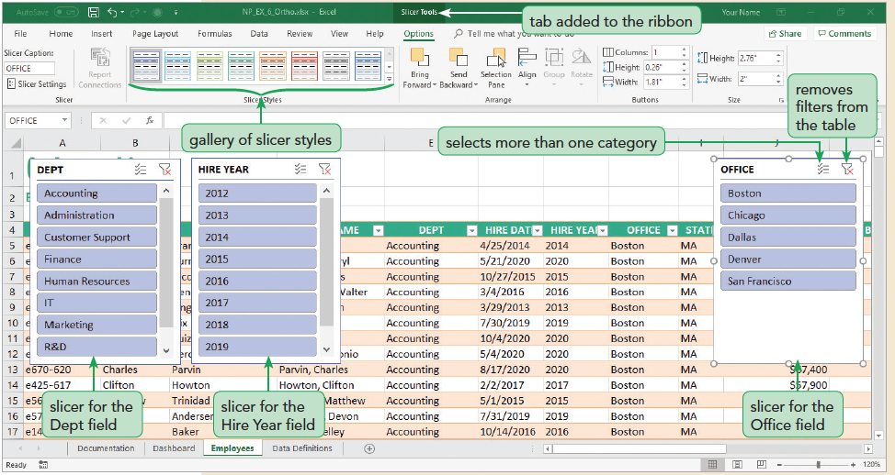
Filtering Data with Slicers, Part 2

Slide 39
Creating a Dashboard, Part 1
A dashboard is a page or screen providing informative visuals of data, key performance indicators, and statistics.
Most dashboards contain interactive tools to help users explore data under different conditions and assumptions.
Formatting a Slicer
By default, slicer buttons are arranged in a single column. You can increase the number of the columns by formatting the slicer.

Slide 40
Creating a Dashboard, Part 2
Using the SUBTOTAL Function
Creating Dynamic Charts
Charts based on Excel tables are dynamic, which means they update automatically as the source data is filtered so that hidden records do not contribute to the chart’s appearance.
This dynamic quality makes charts ideal for dashboards, because the users can see visual representations of the data under varying criteria.

Slide 41
Creating a Dashboard, Part 3
Looking Up Data with Tables
Excel tables work well as lookup tables for the VLOOKUP function.
As you add more records to the lookup table, the VLOOKUP function will automatically include the additional rows.
If you filter the data, the lookup table will be restricted only to those rows that match filter criteria.
Also, you can use the table name as the lookup table reference rather than referencing a range.

Slide 42
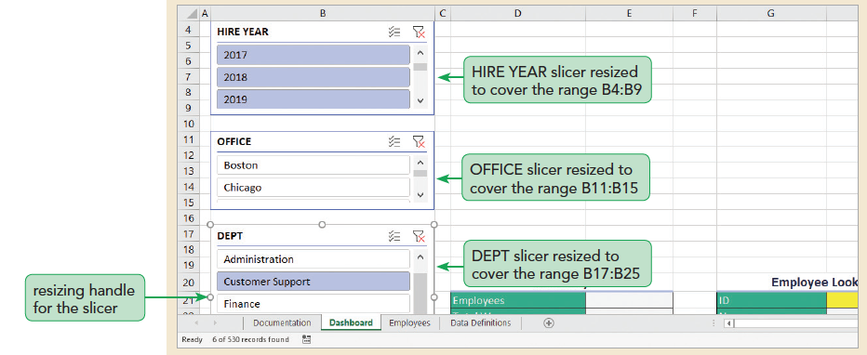
Creating a Dashboard, Part 4

